Slide 1
PRODUCT SALES ANALYSIS

Slide 2
ABSTRACT
The "Product Sales Analysis" machine learning project aims to develop a predictive model that can analyze and forecast product sales based on historical data.
This project utilizes a dataset containing information about product attributes, sales channels, pricing, and time-related factors.

Slide 3
OBJECTIVES
Product sales analysis typically has several objectives, including:
Performance Evaluation, Identifying Trends, Customer Insights, Inventory Management, Competitive Analysis, Profitability Analysis, Marketing Effectiveness, Forecasting, Geographic Analysis, Product Lifecycle Management, Customer Retention, Identifying Growth Opportunities, Cost Reduction, Quality Improvement, Compliance and Reporting
By achieving these goals we would know about the sales, profit of the products.

Slide 4
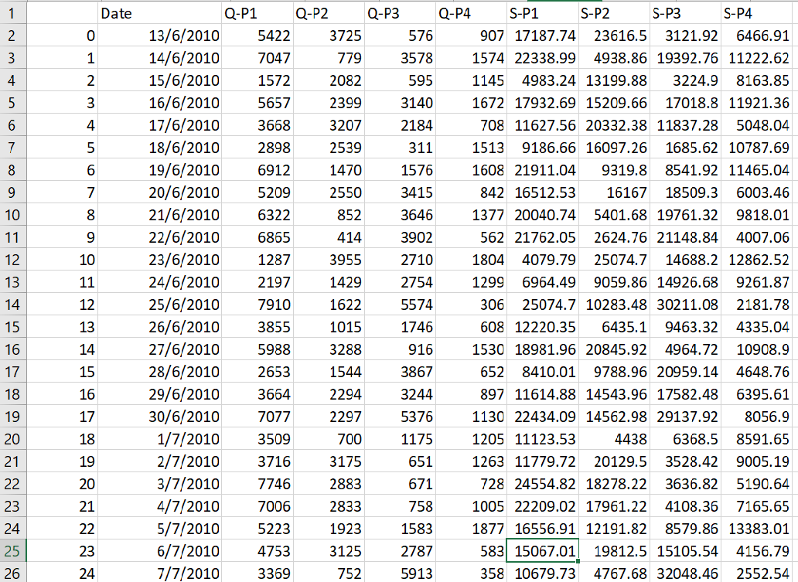
Data Source
Dataset Link:https://www.kaggle.com/datasets/ksabishek/product-sales-data

Slide 5
Visualization
Top-Selling Products:
A bar chart displays the total sales for each of the four products: Product 1, Product 2, Product 3, and Product 4.
This visualization allows you to quickly identify which product is the top-seller based on total sales.
Sales Trends Over Time:
A line chart shows the sales trends over time for each of the four products.
The x-axis represents dates, and the y-axis represents sales amounts.
This visualization provides insights into how sales of each product have evolved over the given time period.
Customer Preferences Correlation:
A heatmap illustrates the correlation between customer preferences for the four product categories: Preference 1, Preference 2, Preference 3, and Preference 4.
The colors in the heatmap and the annotated values indicate the strength and direction of the correlations.
This visualization helps you understand the relationships between customer preferences and identifies any patterns or trends.

Slide 6
1. Import Necessary Libraries:
We start by importing the required Python libraries: Pandas for data manipulation and Matplotlib for data visualization.
2. Read the Dataset:
- We read the dataset from a CSV file. You should replace `’statsfinal.csv'` with the actual file path where your dataset is located.
Program:
import pandas as pd
import matplotlib.pyplot as plt
import seaborn as sns
# Load the data into a DataFrame
data = pd.read_csv("statsfinal.csv")
# Convert the 'Date' column to a datetime type with error handling
data['Date'] = pd.to_datetime(data['Date'], format='%d-%m-%Y', errors='coerce')
# Drop rows with invalid dates (NaT)
data = data.dropna(subset=['Date'])
# Sort the data by date
data = data.sort_values(by='Date')

Slide 7
# Top-Selling Products
top_products = data[['Q-P1', 'Q-P2', 'Q-P3', 'Q-P4']]
top_products.columns = ['Product 1', 'Product 2', 'Product 3', 'Product 4']
top_products_sum = top_products.sum()
top_products_sum.plot(kind='bar', figsize=(10, 5))
plt.title('Top-Selling Products')
plt.xlabel('Products')
plt.ylabel('Total Sales')
plt.show()
# Sales Trends
data.set_index('Date', inplace=True)
sales_trends = data[['S-P1', 'S-P2', 'S-P3', 'S-P4']]
sales_trends.plot(figsize=(12, 6))
plt.title ('Sales Trends Over Time')
plt.xlabel('Date')
plt.ylabel('Sales Amount')
plt.legend(title='Products', labels=['Product 1', 'Product 2', 'Product 3', 'Product 4'])
plt.show()
# Customer Preferences
customer_preferences = data[['S-P1', 'S-P2', 'S-P3', 'S-P4']]
customer_preferences.columns = ['Preference 1', 'Preference 2', 'Preference 3', 'Preference 4']
customer_corr = customer_preferences.corr()
plt.figure(figsize=(8, 6))
sns.heatmap(customer_corr, annot=True, cmap='coolwarm', linewidths=0.5)
plt.title('Customer Preferences Correlation')
plt.show()

Slide 8
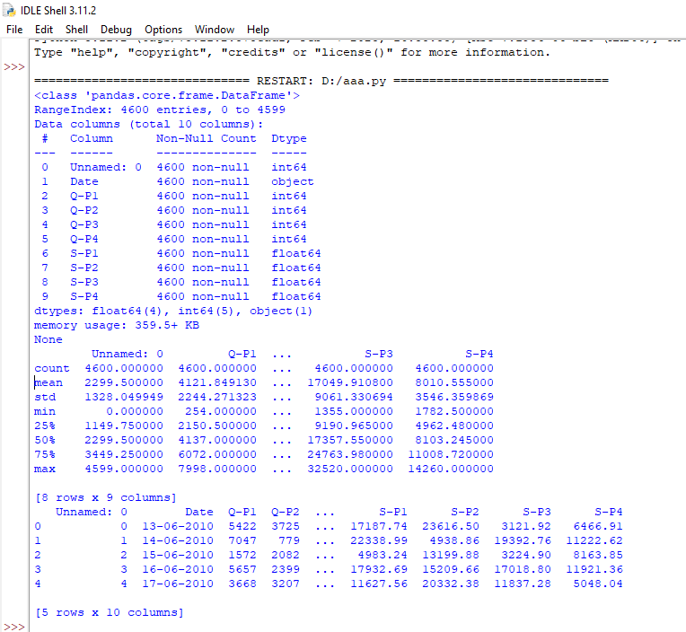
OUTPUT:

Slide 9
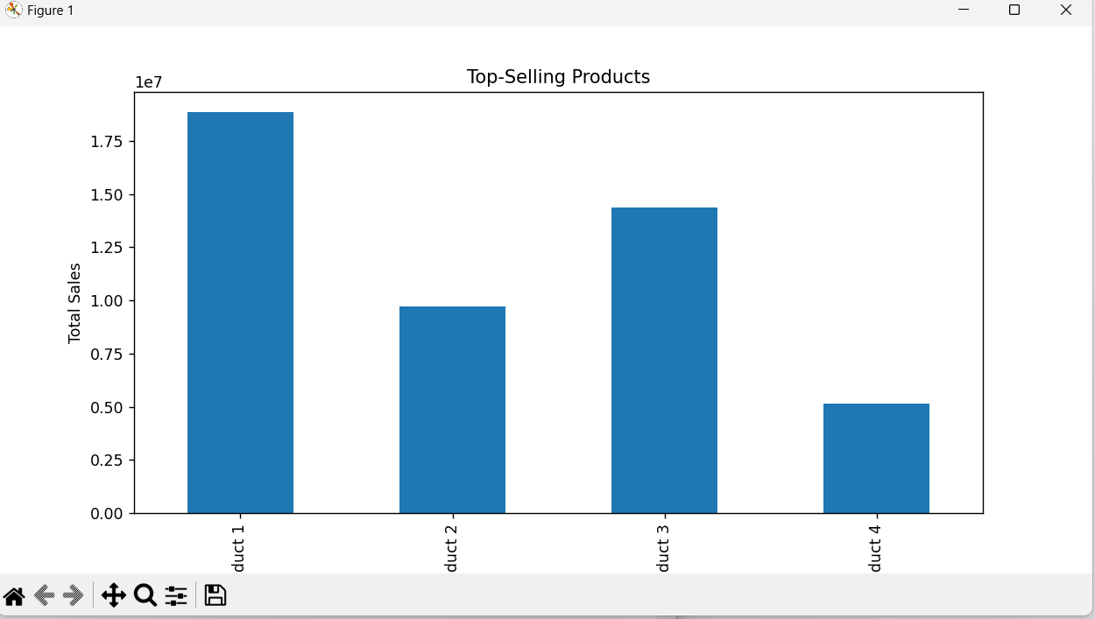

Slide 10
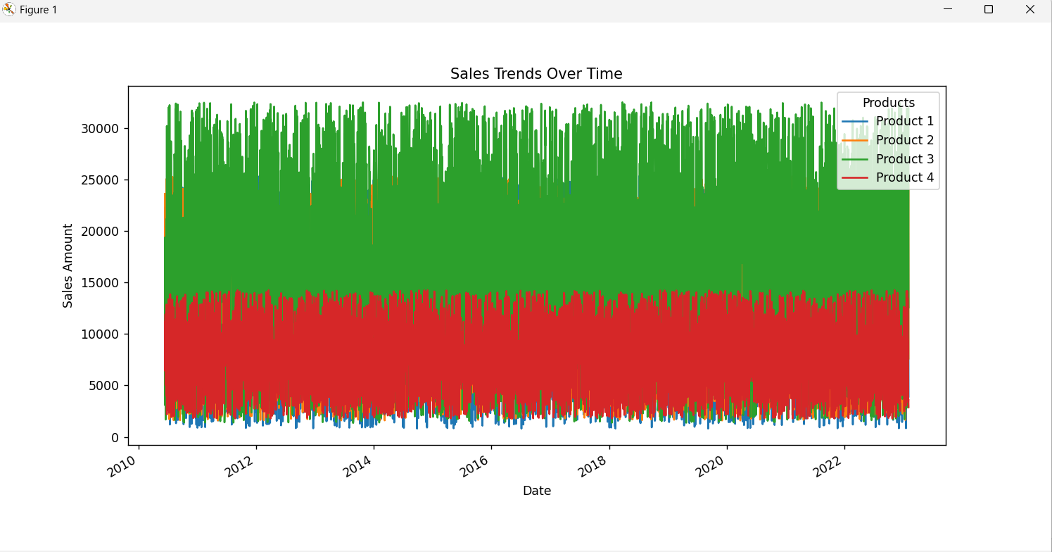

Slide 11
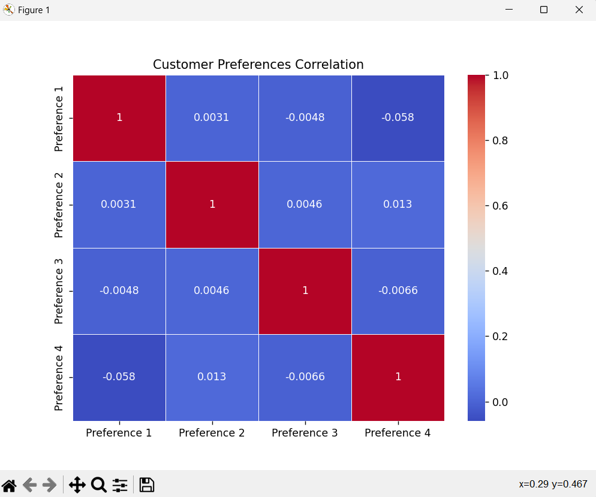

Slide 12
CONCLUSION
The project aims to help businesses optimize their operations, maximize sales, and improve customer satisfaction. It provides a comprehensive solution for analyzing historical sales data and leveraging machine learning techniques to make informed business decisions.
Please note that this is a high-level overview, and the specific implementation details and choice of machine learning models may vary based on the characteristics of your dataset and the goals of your analysis.

Slide 13
THANK
YOU

